Slide 1
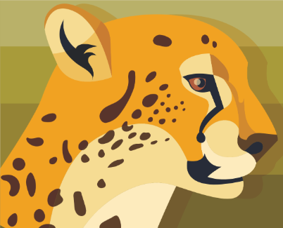
Zoo Project
Jamal and Daniel
Notes:
Banner vector created by freepik - www.freepik.com

Slide 2
Requirements
Core Requirements
Find by Scientific name
Find by Common name (Siberian Tiger, Black Bear, Coyote, etc.)
Look up diet/feeding schedule
Employee sign in
Print out all animal information in a nice formatted view
Look up general care information
Find animals by type (reptile, bird, mammals, etc.)
Supplemental Requirements
What they look like (pictures)
What they do
Where they live on earth
Where can I find them in the Zoo
How many live on earth (endangered?)
Warm or cold blooded?
Height/weight
Land speed/ flying speed
Animal’s name (Freddy the monkey)
Fun facts
How many we have at the zoo
Anything else that a zoo keeper might be asked by customers

Slide 3
Completed Requirements
Core Requirements
Find by Scientific name
Find by Common name (Siberian Tiger, Black Bear, Coyote, etc.)
Look up diet/feeding schedule
Employee sign in
Print out all animal information in a nice formatted view
Look up general care information
Find animals by type (reptile, bird, mammals, etc.)
Supplemental Requirements
What they look like (pictures)
What they do
Where they live on earth
Where can I find them in the Zoo
How many live on earth (endangered?)
Warm or cold blooded?
Height/weight
Land speed/ flying speed
Animal’s name (Freddy the monkey)
Fun facts
How many we have at the zoo
Anything else that a zoo keeper might be asked by customers
Notes:
Yellow supplemental requirements implemented in alternative ways.

Slide 4
Design Considerations
Zoo Keepers: Low technical bar
Something that just works
Ease of use interface is preferable
Limit amount of Technical Support to work, so everyone can contribute and use product.
Limit features
Do not want to do something like D2L where 70% of features are not used; it is confusing because there are too many features that most do not know how to use.
80/20 Rule

Slide 5
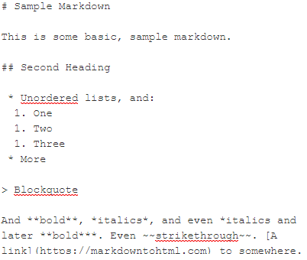
Our Solution
Web Page - easy to access and use
Could also allow zoo visitors to use the site
Markdown for formatting HTML
We explored using Wikipedia Markup but it was far more difficult both in implementation and use.
Simple to use: https://markdowntohtml.com/
Base level of just plain-text can also work
Mobile Friendly and Clean Design
Create and Edit Pages on the Web
Notes:
Example Markdown figure from https://markdowntohtml.com/

Slide 6
Our Solution
Sample Markdown
This is some basic, sample markdown.
Second Heading
Unordered lists, and:
One
Two
Three
More
Blockquote
And bold, italics, and even italics and later bold. Even strikethrough. A link to somewhere.
Web Page - easy to access and use
Could also allow zoo visitors to use the site
Markdown for formatting HTML
We explored using Wikipedia Markup but it was far more difficult both in implementation and use.
Simple to use: https://markdowntohtml.com/
Base level of just plain-text can also work
Mobile Friendly and Clean Design
Create and Edit Pages on the Web
Notes:
Example Markdown figure from https://markdowntohtml.com/

Slide 7
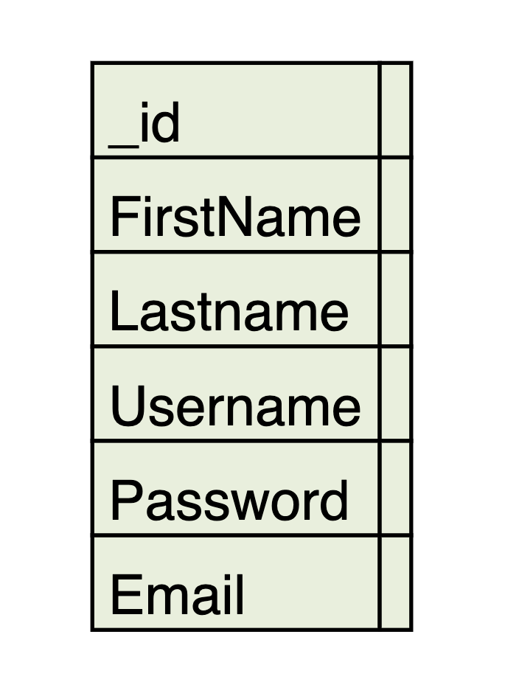
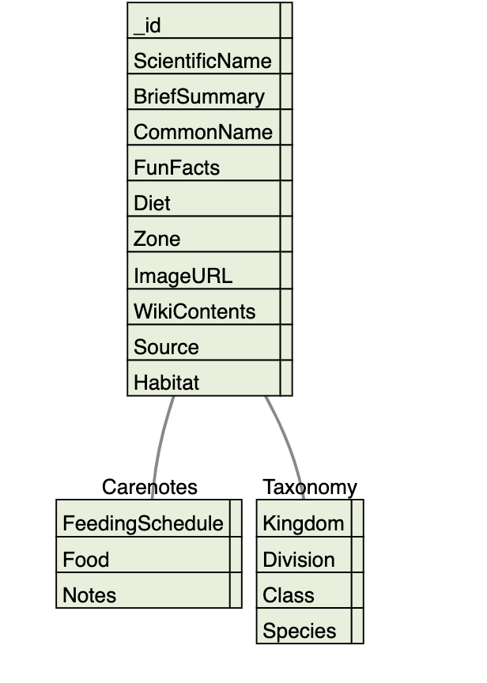
Database Diagram

Slide 8
Language and Framework
Python
Flask FrameWork (Routing/sessions/database manipulation)
BootStrap for template CSS
Bcrypt for password encryption
BeautifulSoup/Requests/Wikipedia

Slide 9
Demo
https://ninth.site:5002/
on AWS EC2
Old version: http://3.89.175.127:5002/

